Slide 1



Slide 2
CATCH THE BALLS
UNDER SUPERVISION OF:
T. M. Amir – Ul – Haque Bhuiyan
Assistant Professor, Dept. of CSE Bangladesh University of Business Technology
001

Slide 3





THE TEAM
Hashibur Rahman Redoy (18192103276)
Hasan Al Mahmud (18192103239)

Slide 4
INDEX
001
003
004
005
INTRODUCTION
LITERATURE REVIEW
SOFTWARE REQUIREMENTS
SYSTEM DESIGN & GAMEPLAY
USER MANUAL
FUTURE WORK
REFERENCES
CONCLUSION

Slide 5
INRODUCTION
001
002
003
User gets a radius of character to touch the balls in order to catch
Balls have a randomized order to spawn
Touching the brown ball (bomb)will end the game
Ball spawning speed goes higher by time
3 kinds of balls are thrown
You can describe the topic of the section here

Slide 6
LITERATURE REVIEW
Primary sources:
Secondary sources:
1.Different apps and Web Sites 2.Suggestions from friends.
1.Reference Materials.

Slide 7
SYSTEM REQUIREMENTS
Hardware requirements
Software and tools required:
Programming Language
1.Processor: Intel Core i3 or above. RAM: 8GB or more 2.Android Version lollipop. RAM: 2GB or more
1.Android Studio
Java, html , CSS

Slide 8
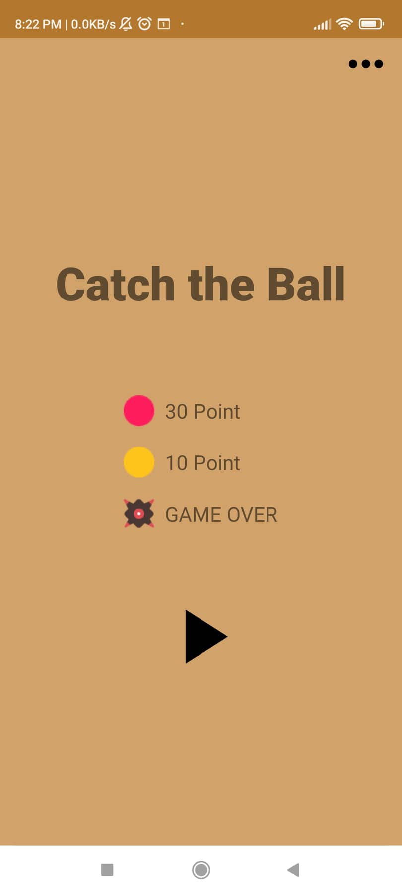
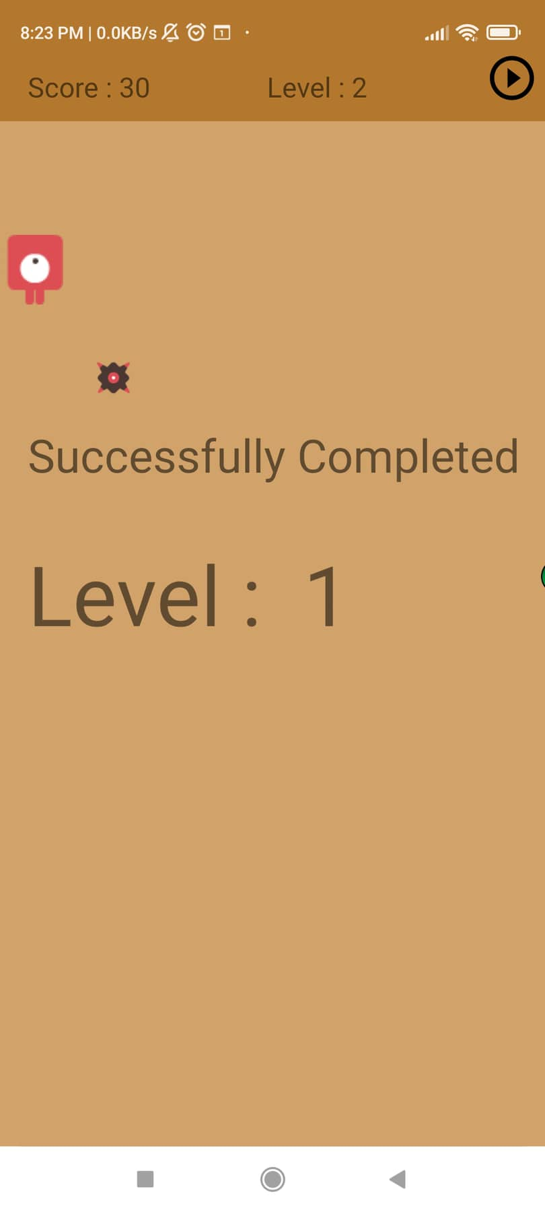
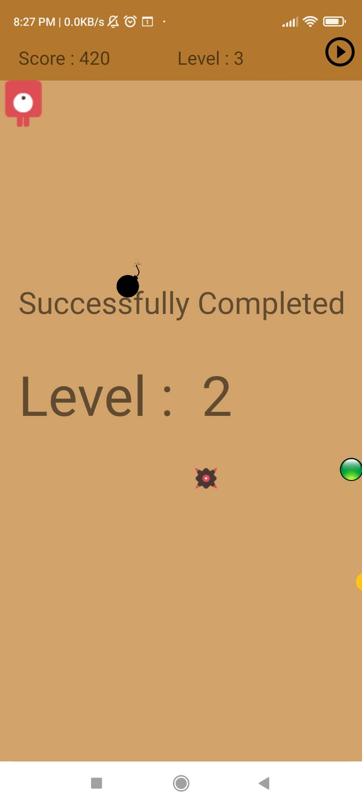
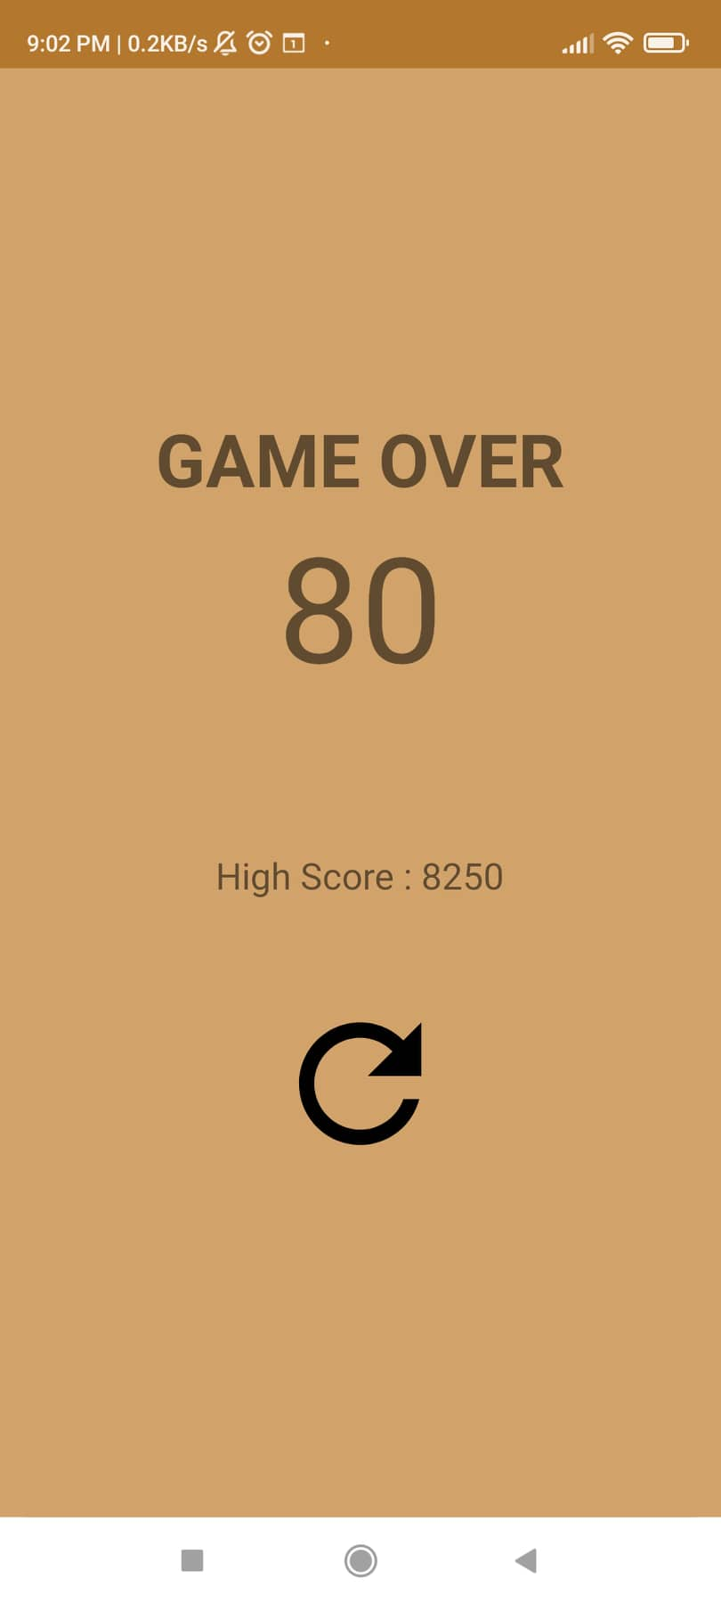
SYSTEM DESIGN AND GAMEPLAY
001
003
005

Slide 9
USER MANUAL
001
003
004
005

Slide 10

FUTURE WORK
1.Improve The level and the background
2.Include a individual mapping system
3.Add Story mode for this System
4.Improve Ui/Ux
5. Add purchase and release the game on play store

Slide 11
CONCLUSION
This gaming project is more similar to an engine.
We aim to create a setup for this game and coordinate internals that will make this gaming platform a revolutionary evolution.
This change will give the user a new experience.

Slide 12
REFERENCES
https://www.tutorialspoint.com/catching-the-ball-game-using-pythonn https://www.geeksforgeeks.org/python-catching-the-ball-game
https://www.slideshare.net/samrinriya/game-using-java
https://github.com/cis3296s22/Java-Brick-Breaker-Game
https://betterprogramming.pub/create-the-classic-ping-pong-game-3aea1f7b16e6

Slide 13
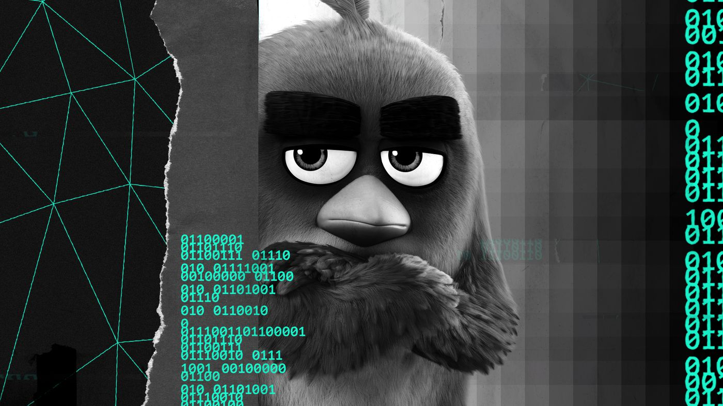
Any
Questions?

